Slide 1

BELGIUM DAYS
6th grade

Slide 2
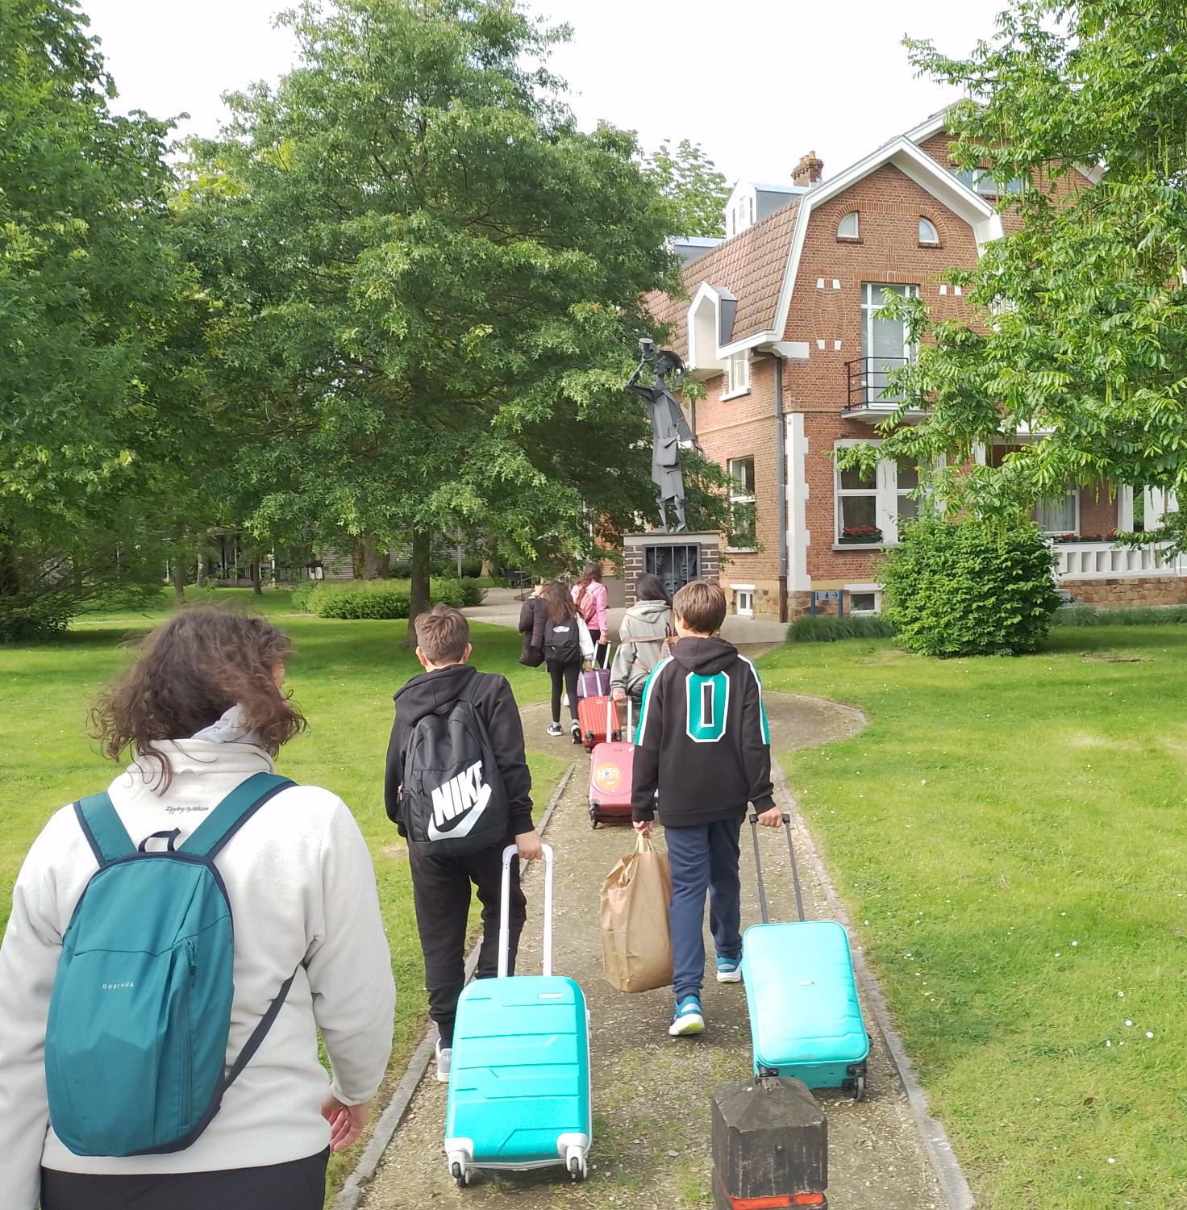
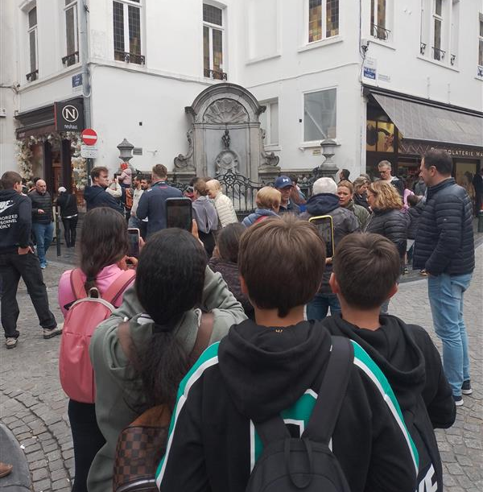
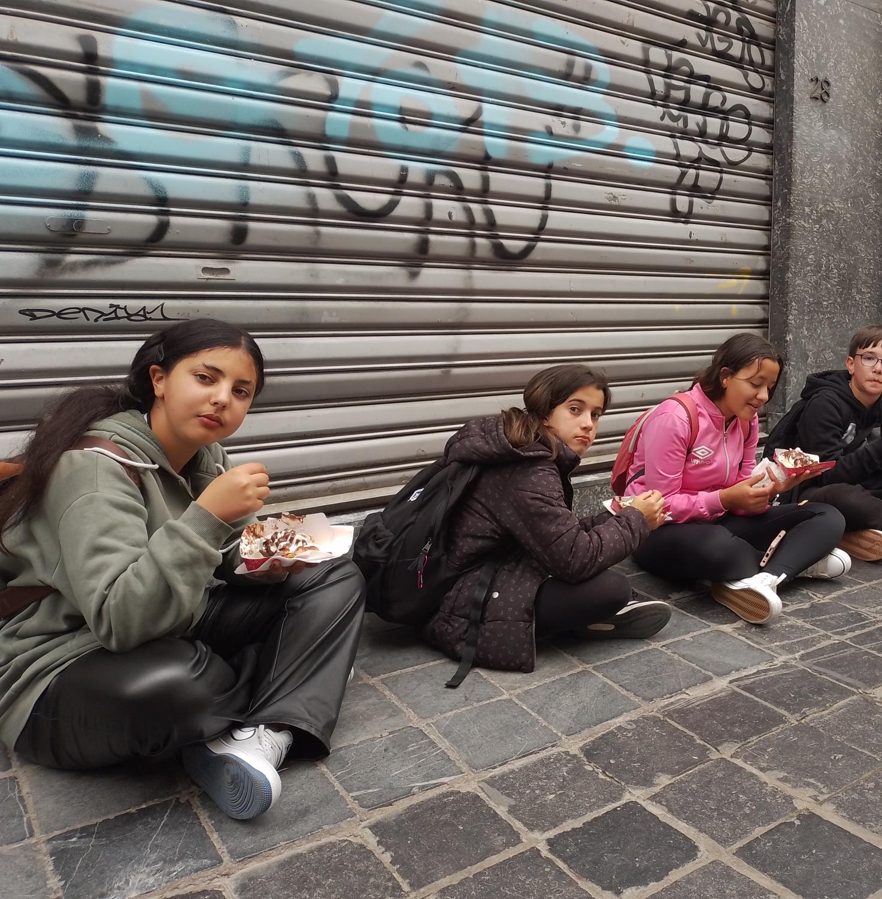
SUNDAY
ON SUNDAY WE TOOK A PLANE FROM MADRID TO BRUSSELS, WE SPENT THE DAY THERE, WE ATE PIZZA AND THEN WE TOOK A WALK AROUND THE CITY, WE WENT TO A CHINESE TO GET SOME CHEWING GUM, THEN WE WENT STRAIGHT TO SEE THE MANEKENPIS TO SEE IF HE WAS WEARING THE MADRID SHIRT BUT IT TURNS OUT HE DIDN'T HAVE IT THEN WE WENT FOR A WAFFLE, IT WAS VERY TASTY, THEN WE TOOK A TRAIN TO BRUGES, IN BRUGES WE TOOK A BUS TO THE HOSTEL, IT WAS IN MALDEGEM, WHEN WE ARRIVED AT THE HOSTEL WE WERE PLAYING FOOTBALL, THEN WE WENT THROUGH THE PRESENTATIONS AND WENT TO BED.

Slide 3
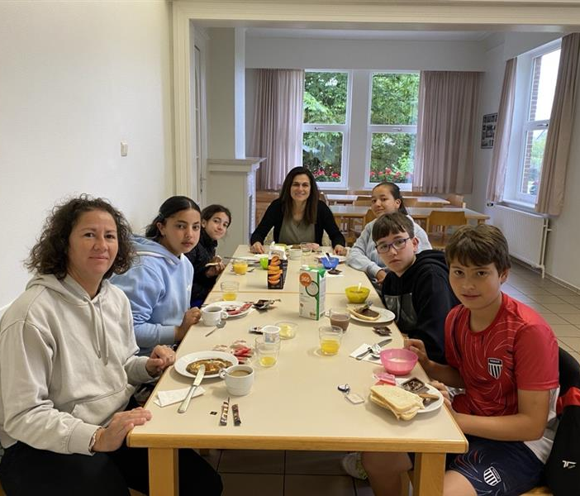
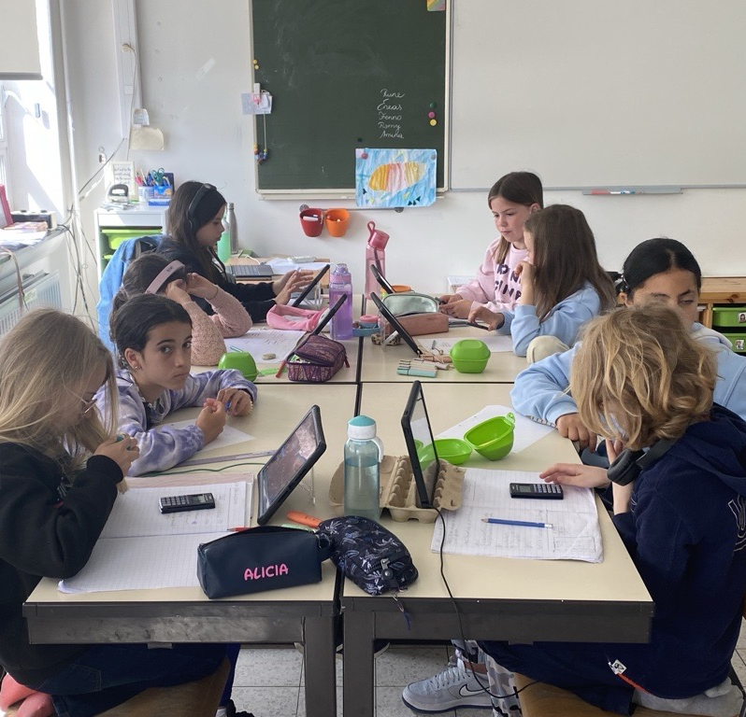
MONDAY
WHEN WE WOKE UP WE WENT TO HAVE BREAKFAST AT THE OWNER'S HOUSE.
WE WENT TO SCHOOL WALKING WHEN WE GET THERE WE STARTED READING.
LATER WE DID MATH THEN WE WENT TO RECESS FOR 15 MINUTES.
AFTER BREAK WE DID LENGUAGE, LATER WE WENT TO THE HOSTEL AND REST. AFTER RECESS WE HAD LENGUAGE AT 12 IN THE MORNING WE ATE IN THE SCHOOL DINING ROOM THEN WE WENT TO RECESS 1 HOUR, LATER WE WENT TO THE HOSTEL AND REST A LITTLE AND THEN WE HAD SNACK
THEN IN THE AFTERNOON WE PLAYED FOOTBALL GAME ALL TOGETHER.

Slide 4
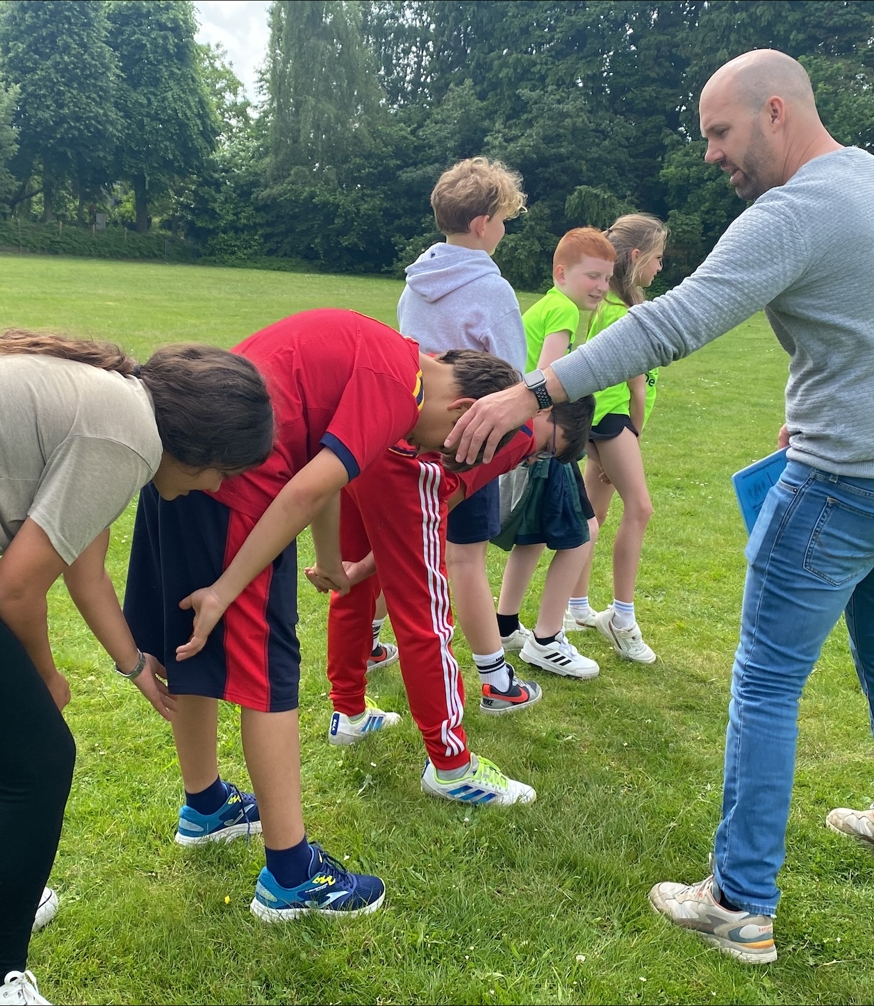
TUESDAY
ON TUESDAY WE WOKE UP AT 7 AM IN THE MORNING, WE PUT ON OUR CLOTHES AND WENT TO HAVE BREAKFAST. THEN WE BRUSHED OUR TEETH AND WENT TO SCHOOL.
AFTER LEAVING SCHOOL WE WENT TO THE HOSTEL, WE PLAYED A LITTLE AND THEN WE ALL WENT TO SHOWER, LATER WE WENT TO PIZZA HUT FOR SOME PIZZAS BECAUSE WE WERE VERY HUNGRY. THEN WE RETURNED TO THE HOSTEL TO EAT THERE.
THEN WE STARTED PLAYING ONE WITH THE TEACHERS. AFTER A FEW MINUTES WE WENT TO SLEEP.

Slide 5
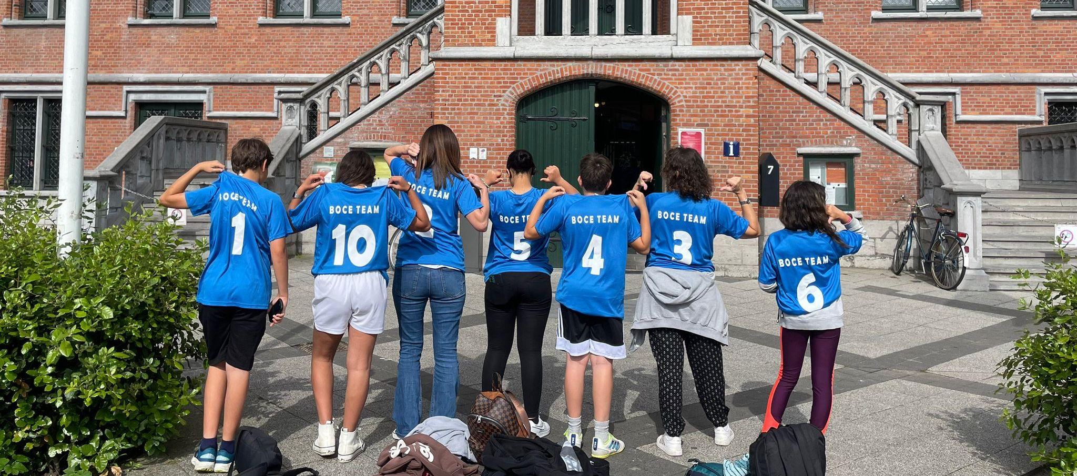
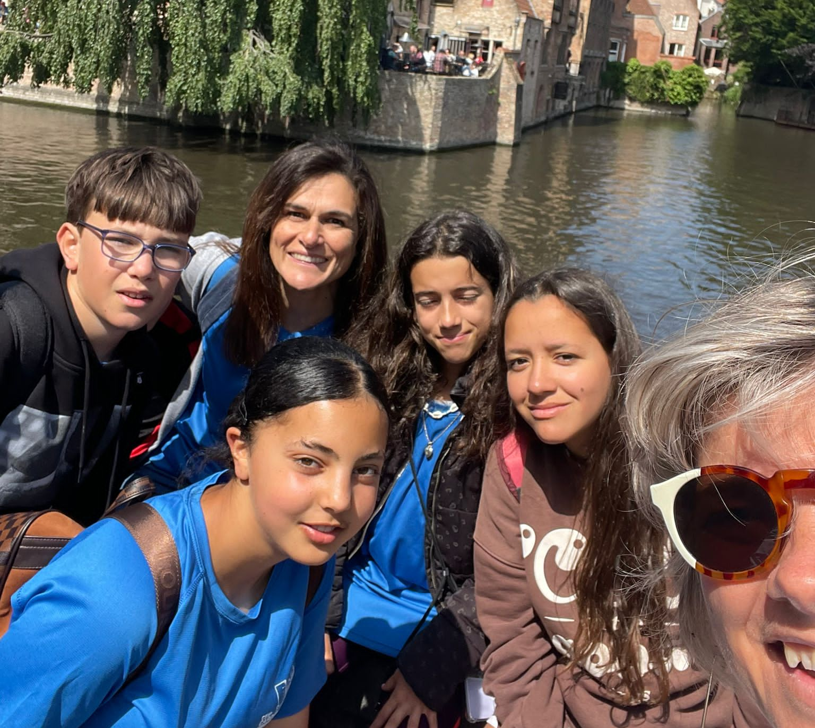
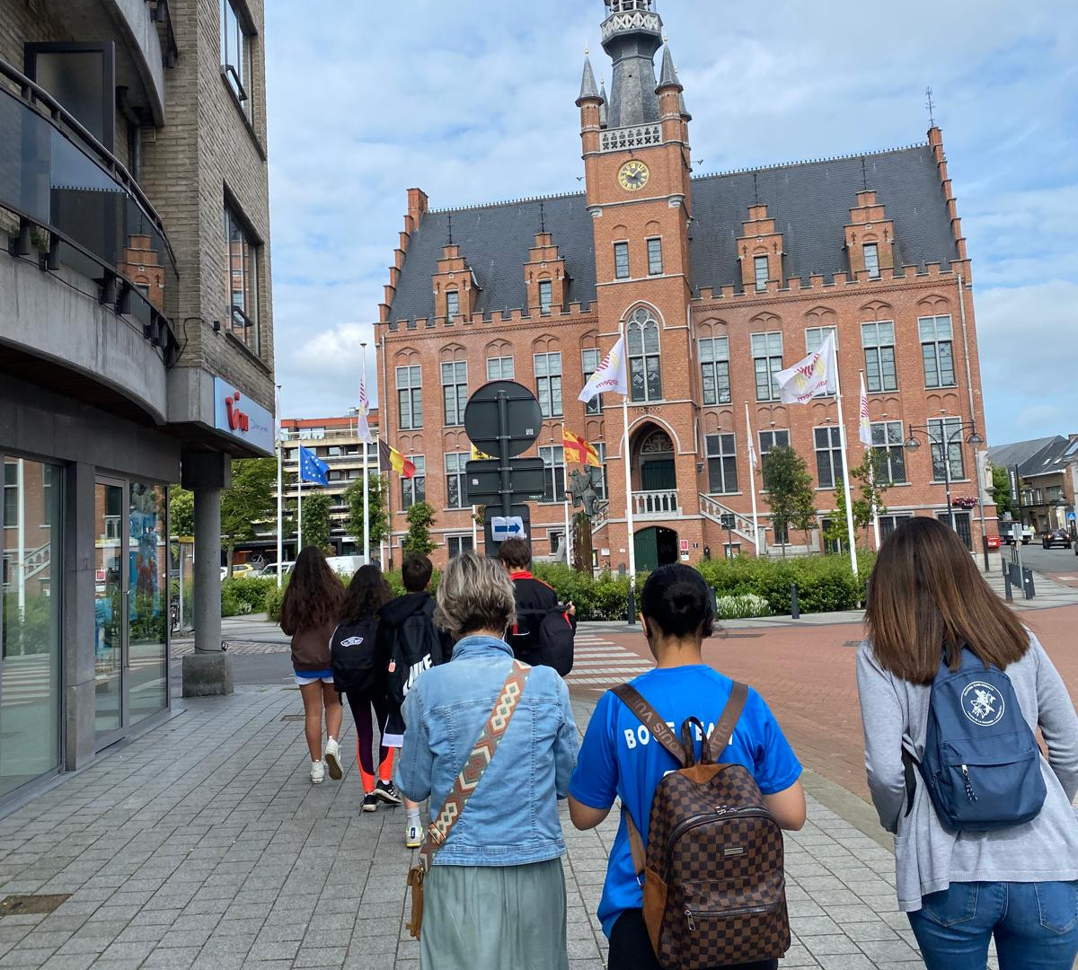
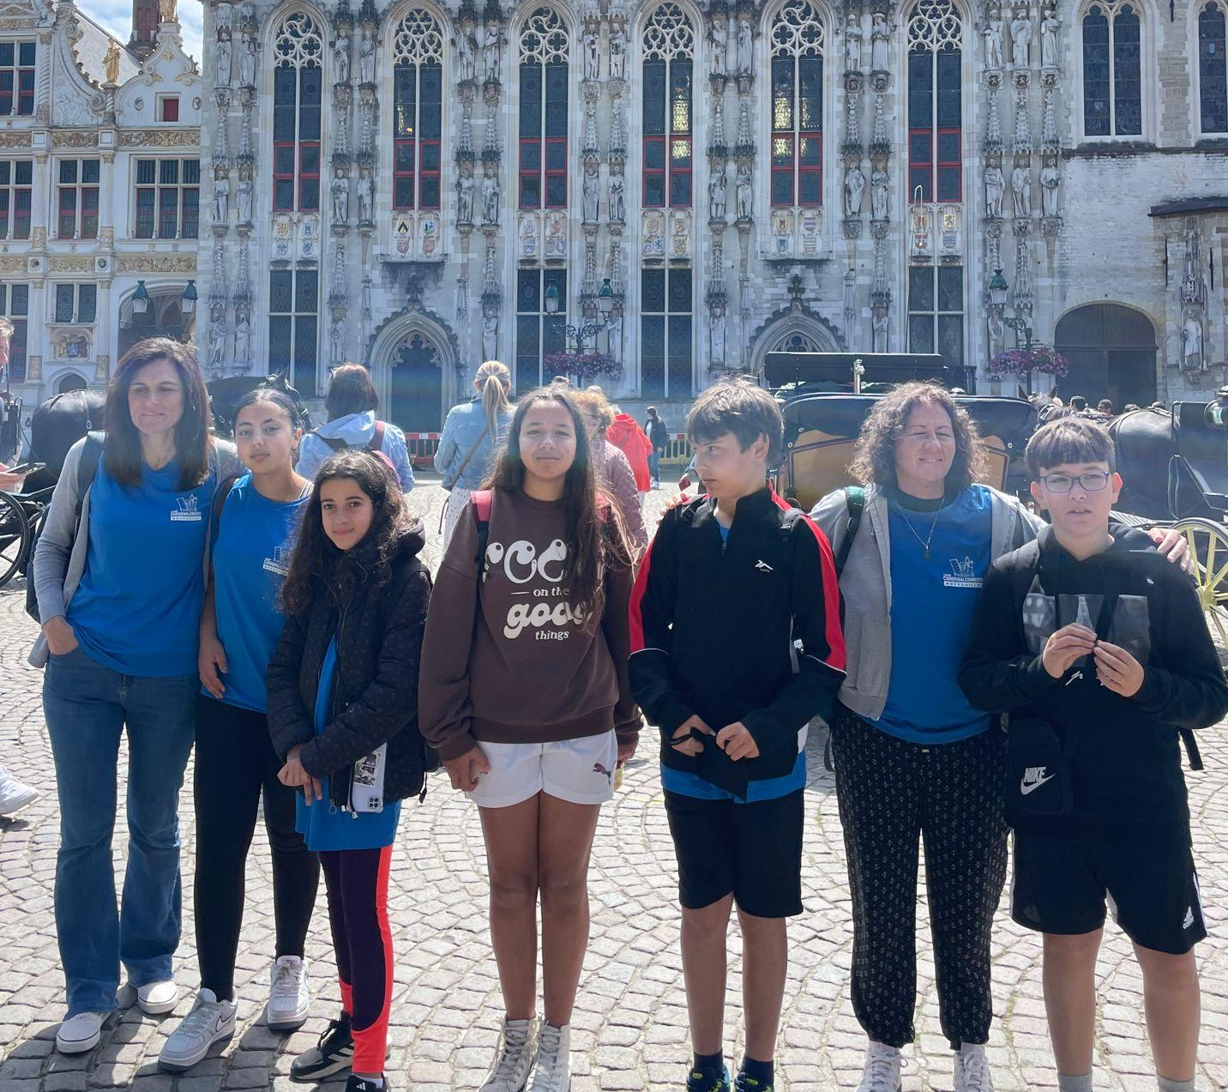
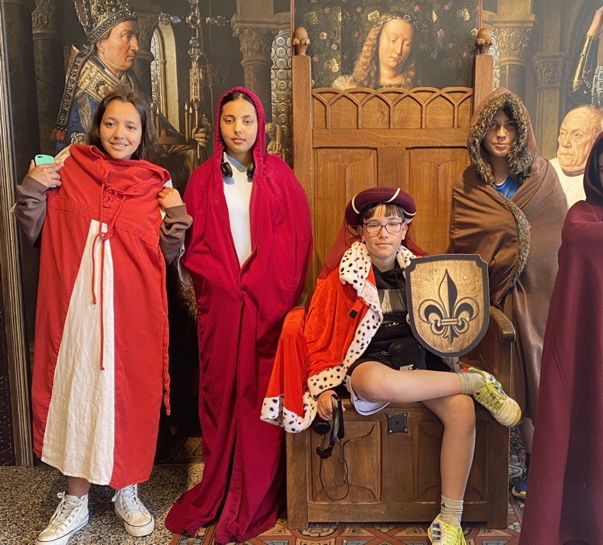
WEDNESDAY
We woke up and went to breakfast, shortly after, while the children were going to school we were on the bus, heading to Brussels, the capital of Belgium. There we bought souvenirs and visited the town where the emperor's new clothes were recorded. We went to a museum where they put us on virtual reality glasses in which they showed us what Brussels was like in the Middle Ages and what ships were like.

Slide 6
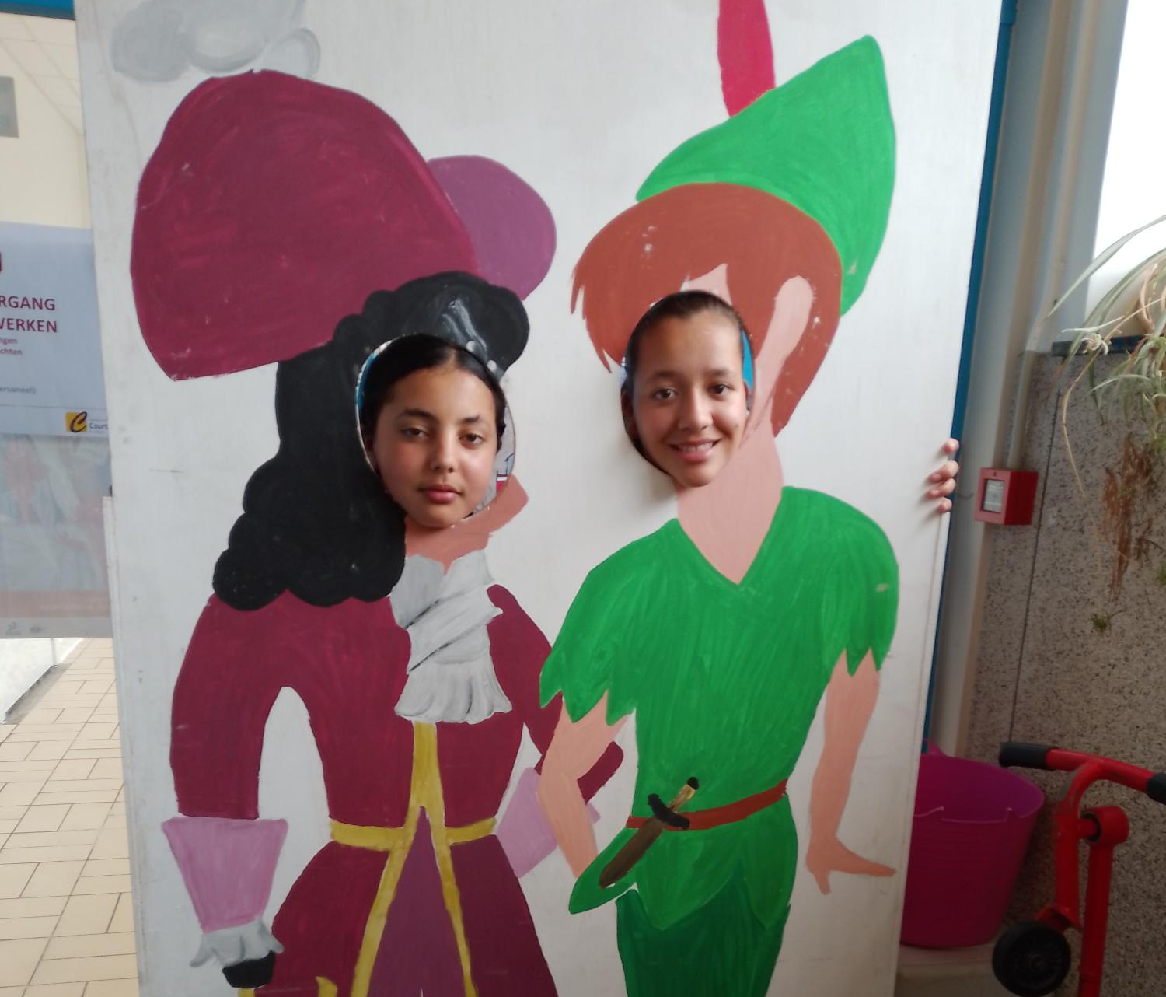
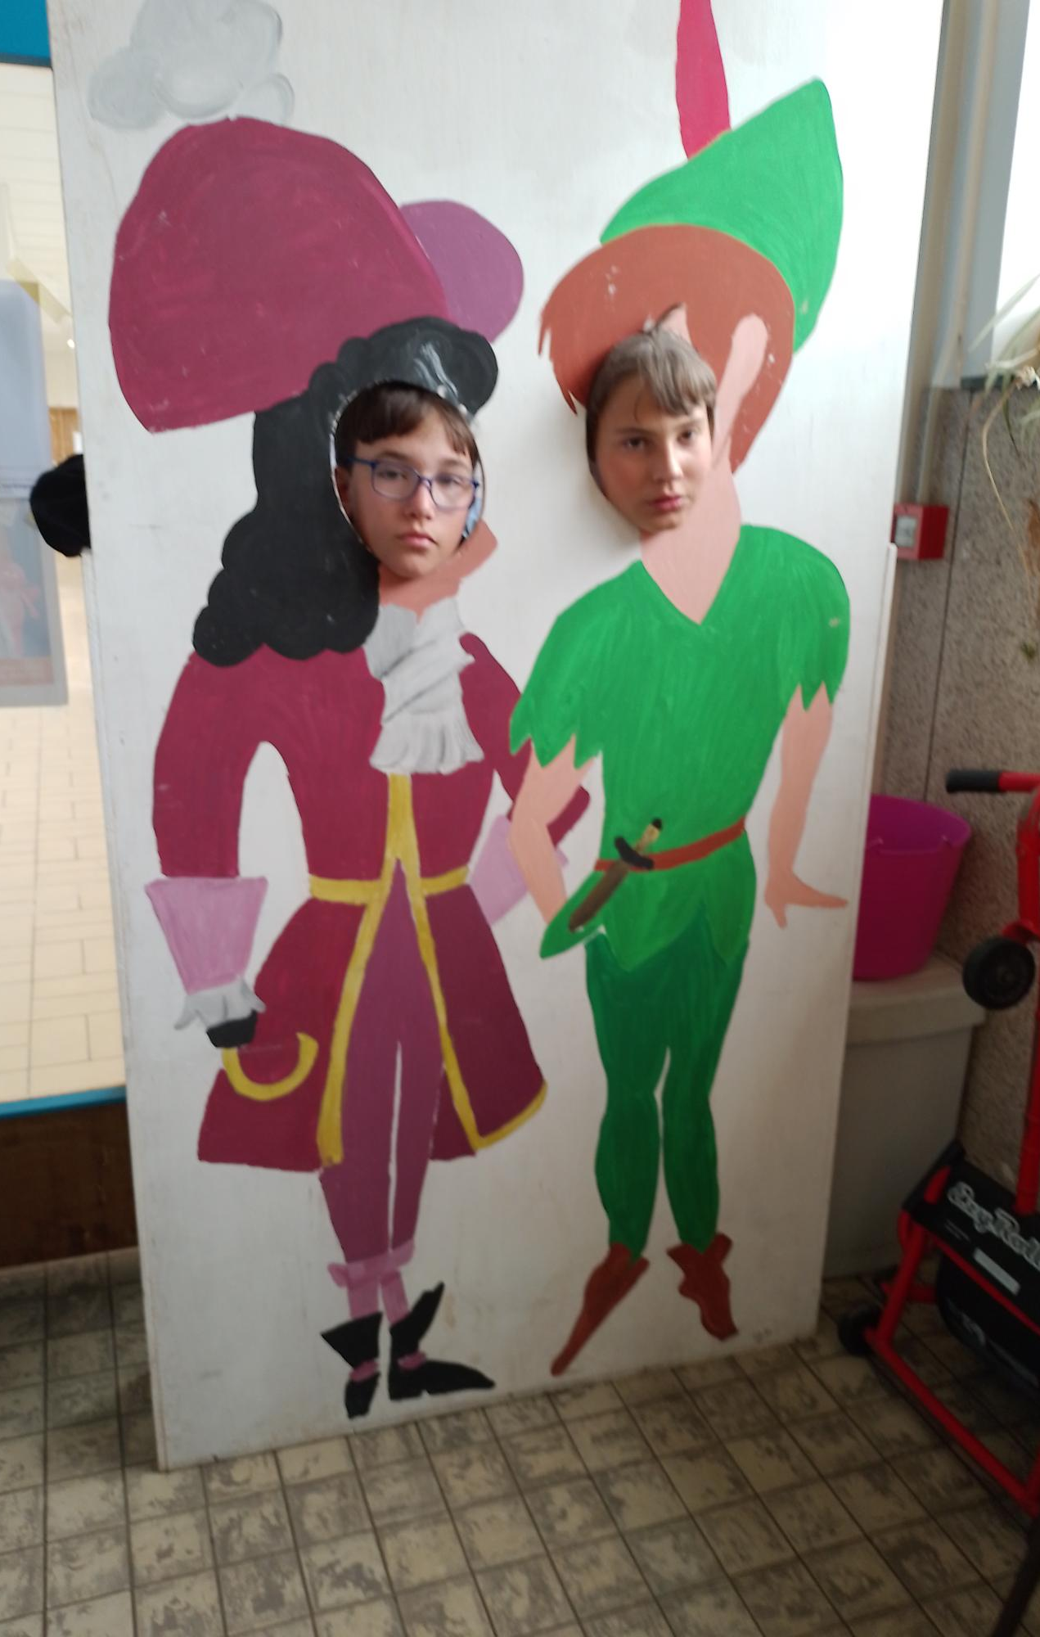
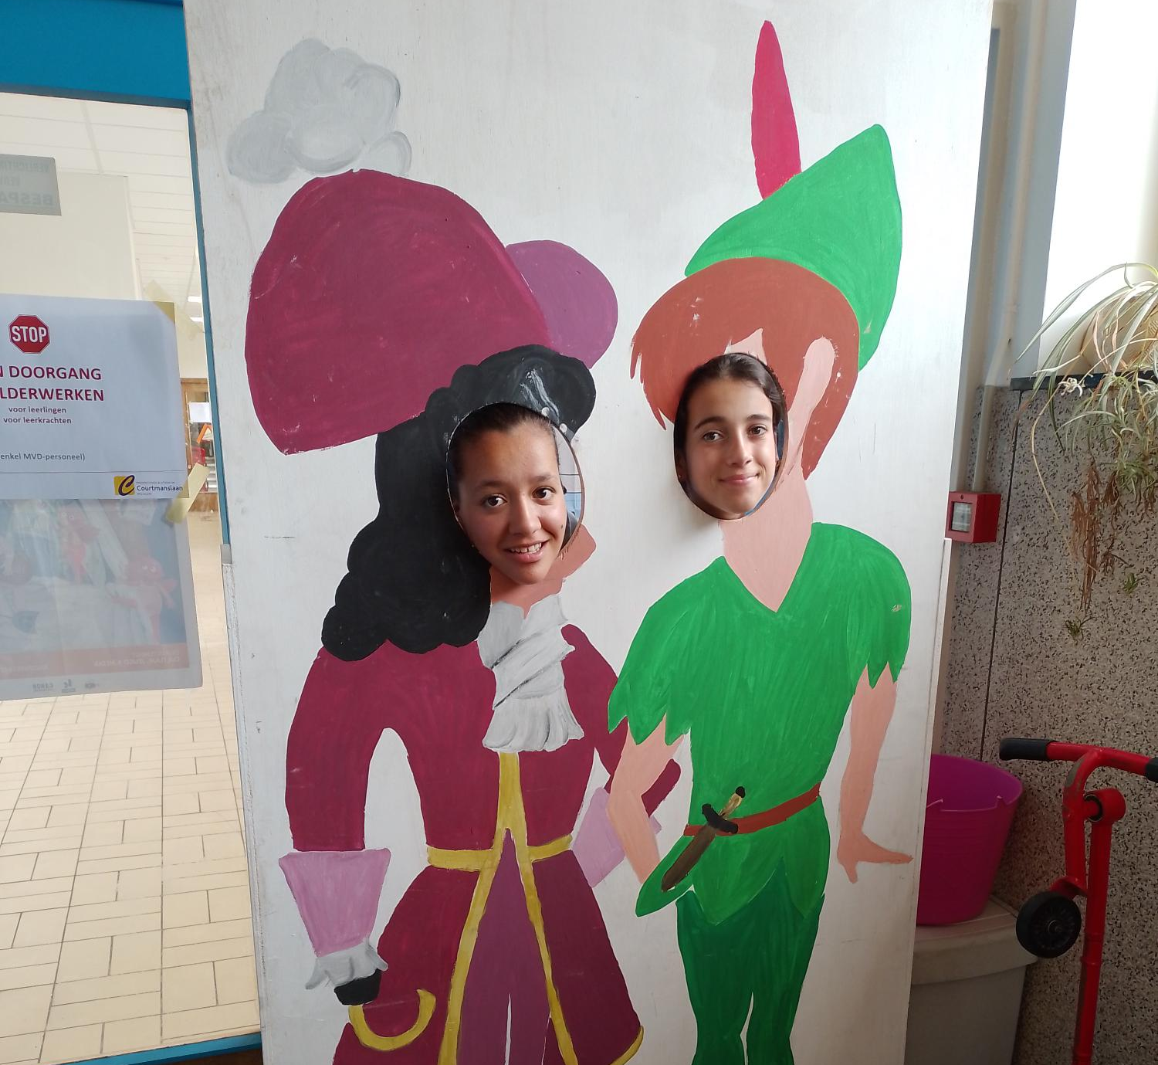
THURSDAY IN THE MORNING
ON THURSDAY MORNING WE WERE AT SCHOOL, WE DID MATH AND THEN WE DID LANGUAGE, THEN WE HAD A FIFTEEN- MINUTE BREAK. THEN AFTER THE BREAK WE DID A LITTLE READING AND WENT TO EAT.

Slide 7
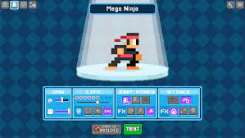

THURSDAY IN THE AFTERNOON
We program our own video game with the characters of the Emperor's new clothes with Bloxels. It is an app in which you can create your characters, the animations of the characters and your own game with coins, Mario Bros style.We played a bit of a game with Maartin, Iby and Mint, we also showered them and ate a kebab, it looked like lasagna.

Slide 8
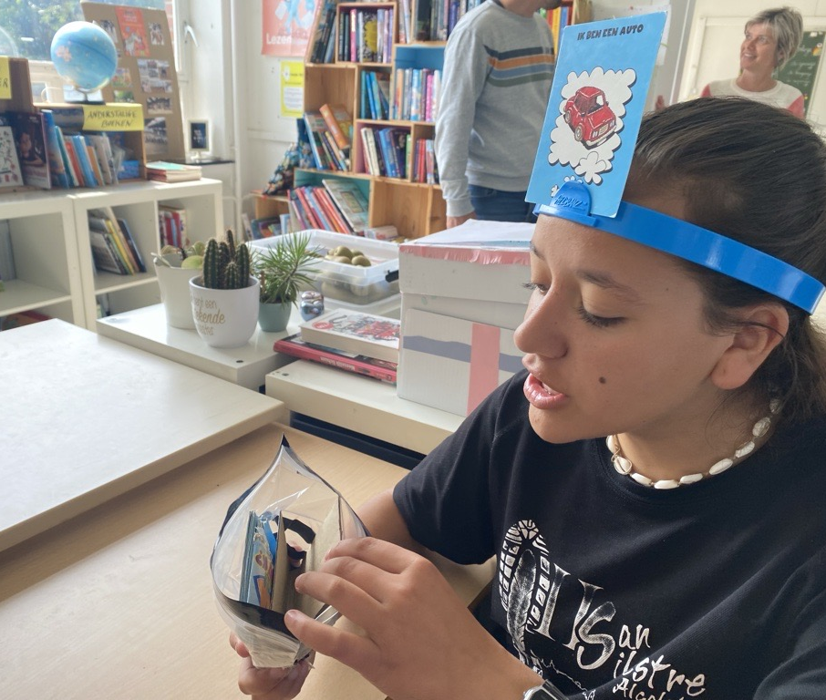
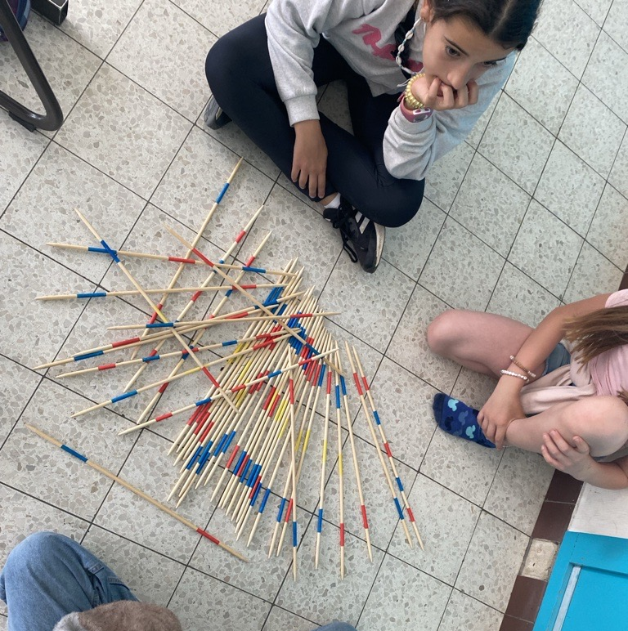
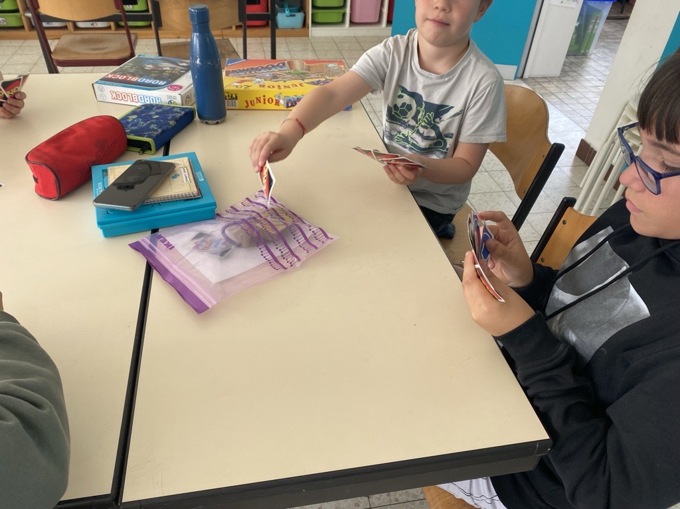
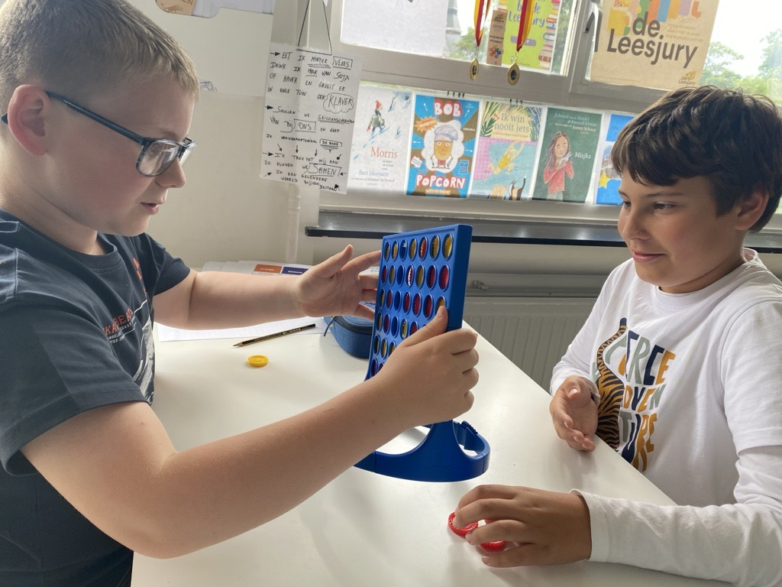
FRIDAY MORNING
ON FRIDAY MORNING WE WOKE UP AT HALF SEVEN, WE PUT ON OUR CLOTHES AND WENT TO HAVE BREAKFAST, THEN WE BRUSHED OUR TEETH AND WENT TO A STORE CALLED SPAR TO BUY CHOCOLATE FOR OUR FAMILTY.
THEN WE RETURNED TO SCHOOL AND WE STARTED PLAYING GAMES WITH THE CHILDREN, GAMES LIKE: UNO, MICADO, GUESS WHO I AM... AND MANY MORE GAMES.
THEN WE RETURNED TO THE HOSTEL AND ATE THE FOOD THEN WE PLAYED A GAME WITH THE TEACHERS

Slide 9
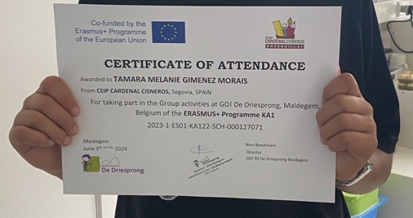
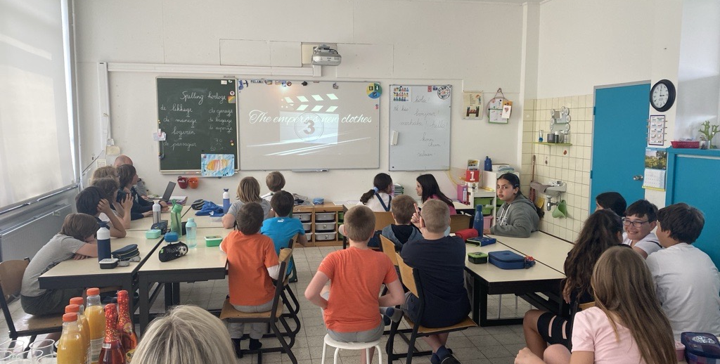
FRIDAY IN THE AFTERNOON.
AT THE END OF THE CLASS THEY GAVE US A CERTIFICATE AND WE WATCHED A MOVIE, WHILE WE ATE POPCORN AND CANDY
WE WENT TO A ROOM IN FRONT OF THE HOSTEL, IT HAD SEVERAL SOFAS AND A MINI STAGE.
ON STAGE EVERYONE DID THEIR PERFORMANCE SOME DANCED AND OTHERS SANG.

Slide 10
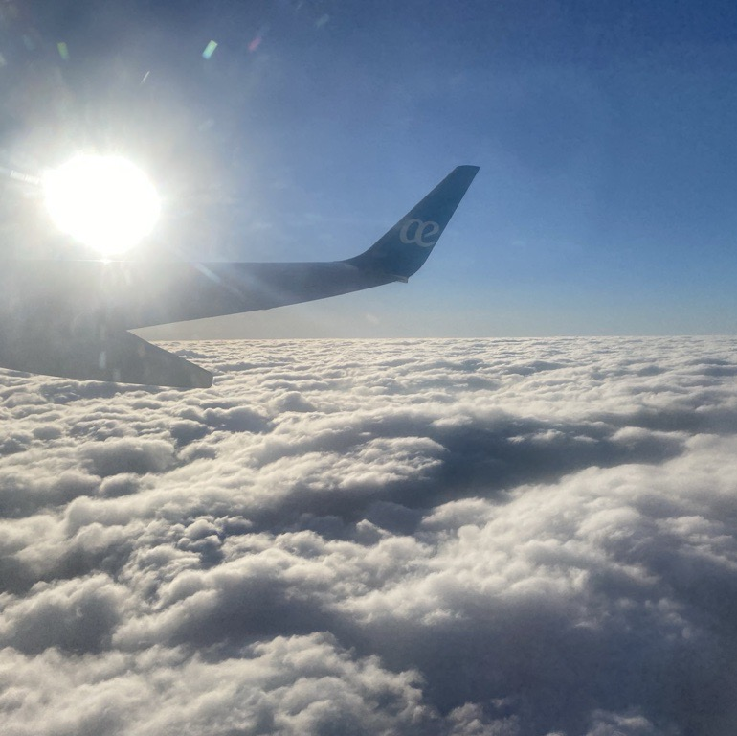
SATURDAY IN THE AFTERNOON
We had taken the bus to take us to the center of Bruges and then go by train to Brussels. We took the opportunity to eat spaghetti bolognese. We went to the airport and bought some snacks for the plane. The flight left at 6:55 p.m. but was delayed until 8:15 p.m., in the end we got on the plane and arrived in Madrid, at 12:30 p.m. we were in Boceguillas.

Slide 11
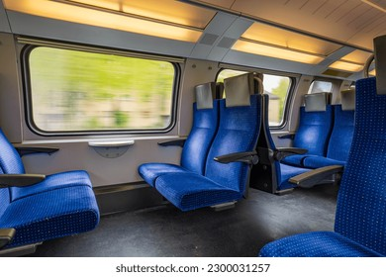
SATURDAY MORNING
ON SATURDAY MORNING WE WERE PLAYING FOOTBALL, THEN WE SAID GOODBYE TO MINT, MAARTEN, EVE AND TOOK A BUS TO BRUGES, THEN WE TOOK A TRAIN TO BRUSSELS

Slide 12

This has been our trip with Erasmus+

